Slide 1
SVC Kmer DNC

Slide 2
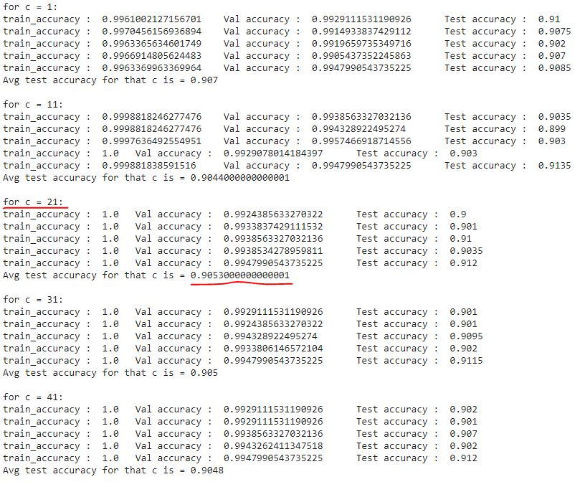
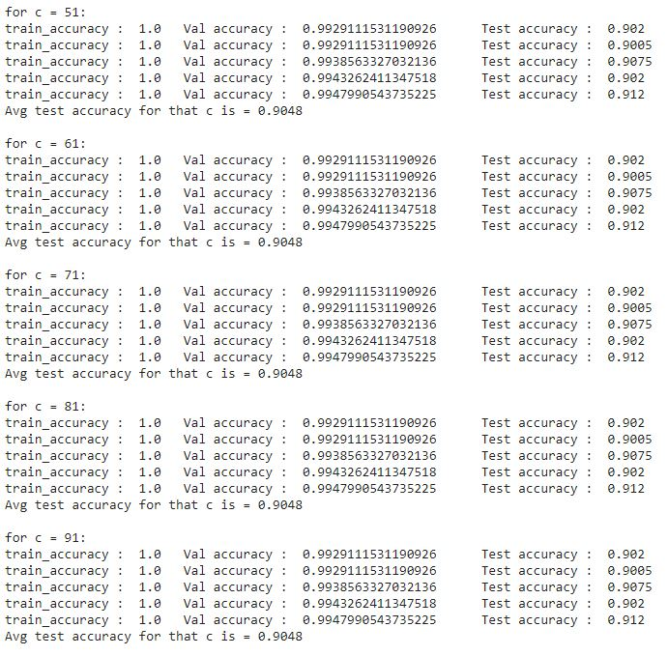
Here for c = 21, I got highest average test accuracy

Slide 3
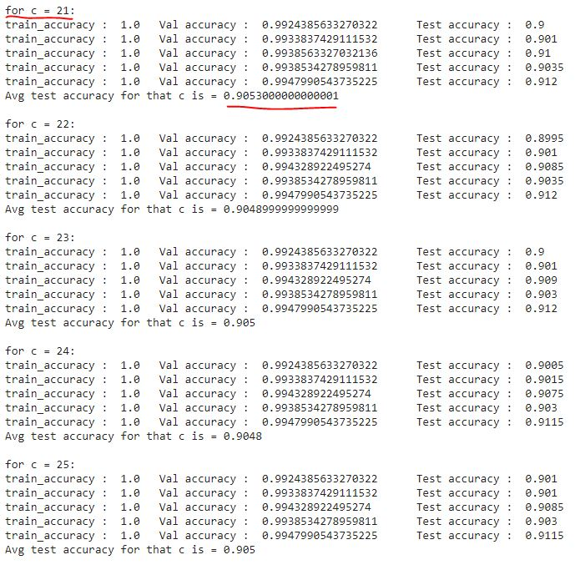
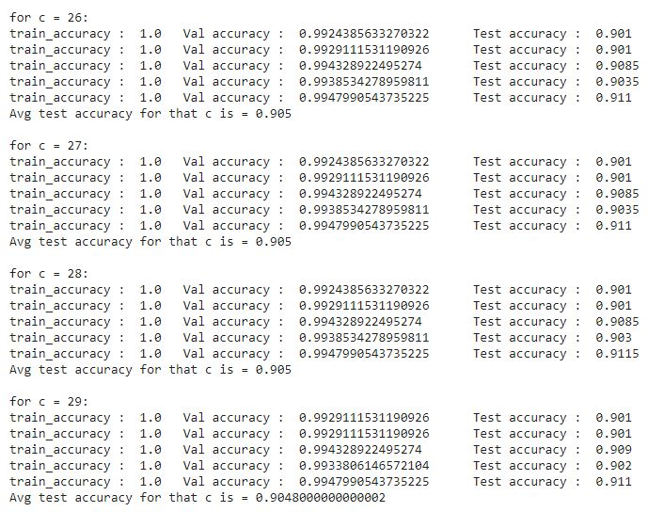
Here for c = 21, I got highest average test accuracy

Slide 4
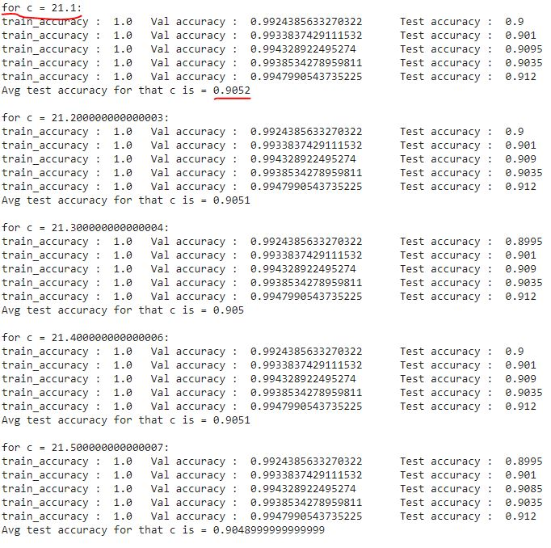
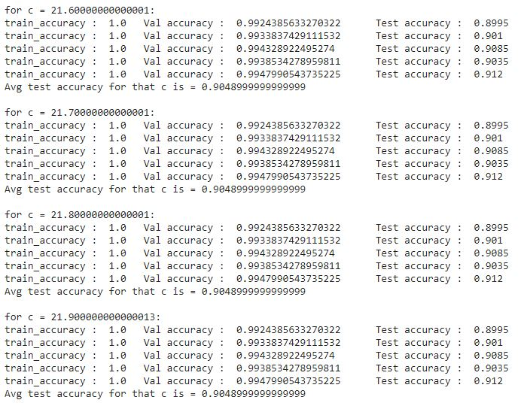
Here for c = 21.1, I got highest average test accuracy
So I choose c = 21.1

Slide 5
SVC Kmer TNC

Slide 6
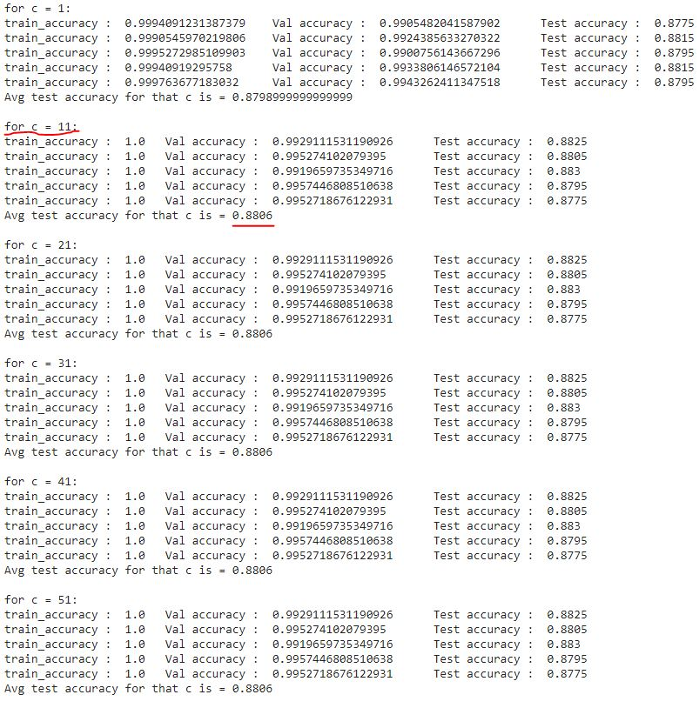
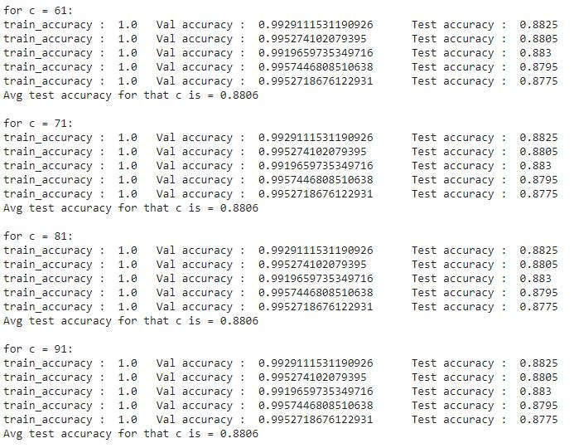
Here for c = 11, I got highest average test accuracy

Slide 7
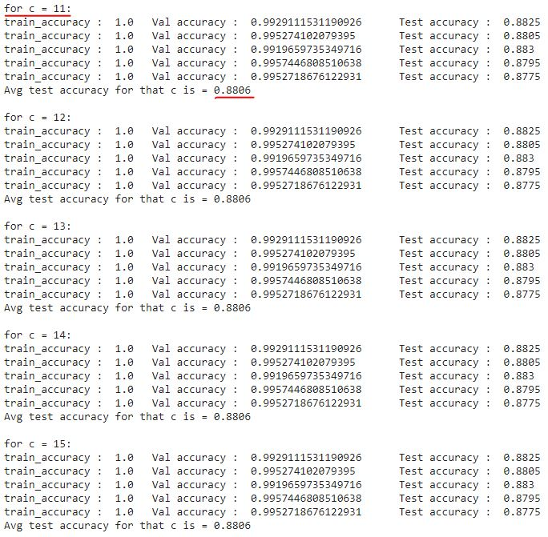
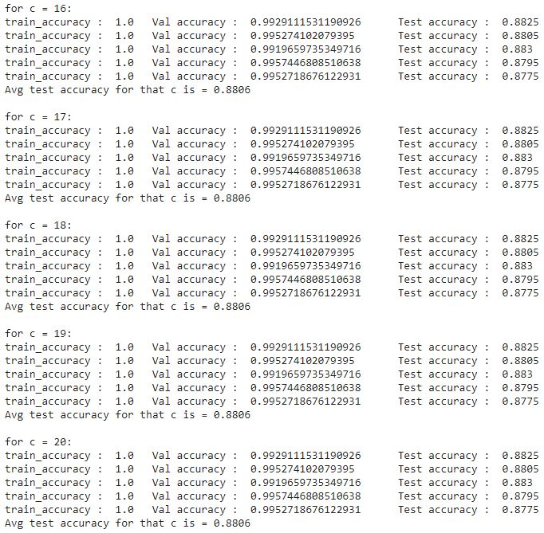
Here for c = 11, I got highest average test accuracy

Slide 8
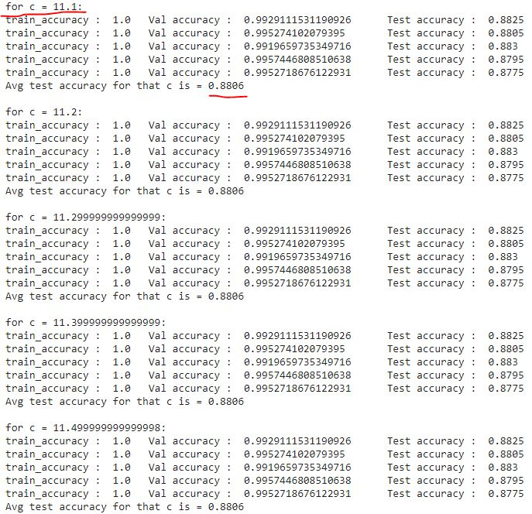
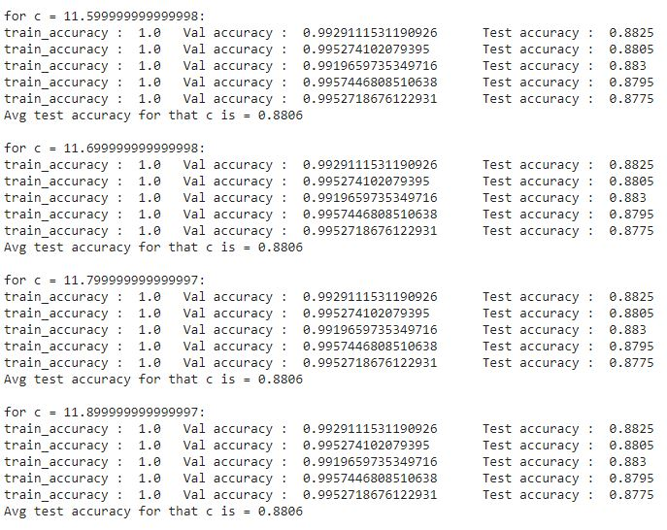
Here for c = 11.1, I got highest average test accuracy
So I choose c = 11.1

Slide 9
SVC Kmer (DNC + TNC)

Slide 10
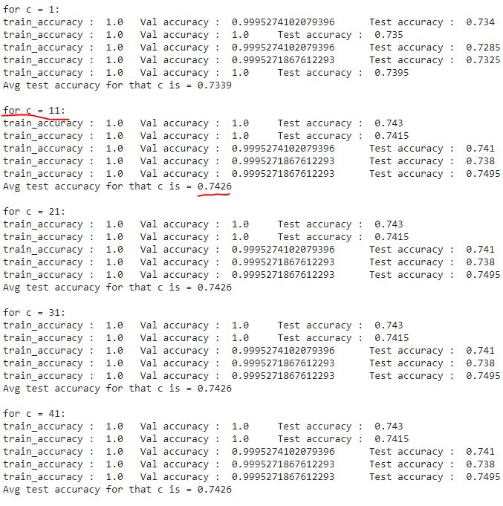
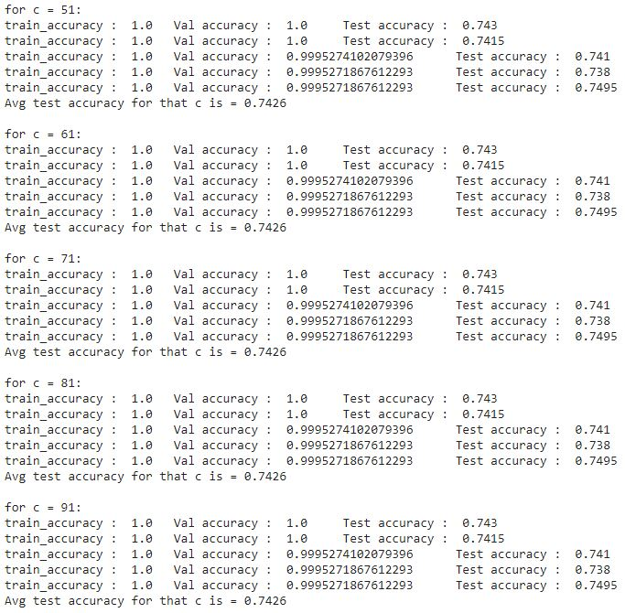
Here for c = 11, I got highest average test accuracy

Slide 11
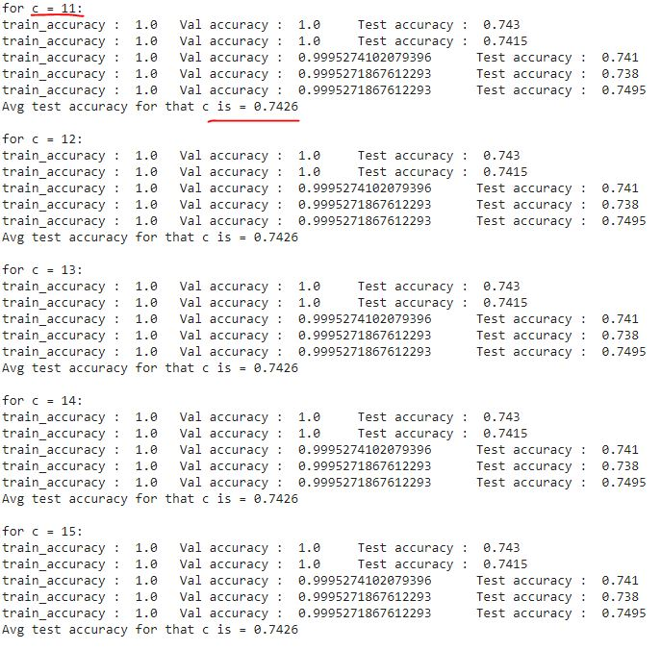
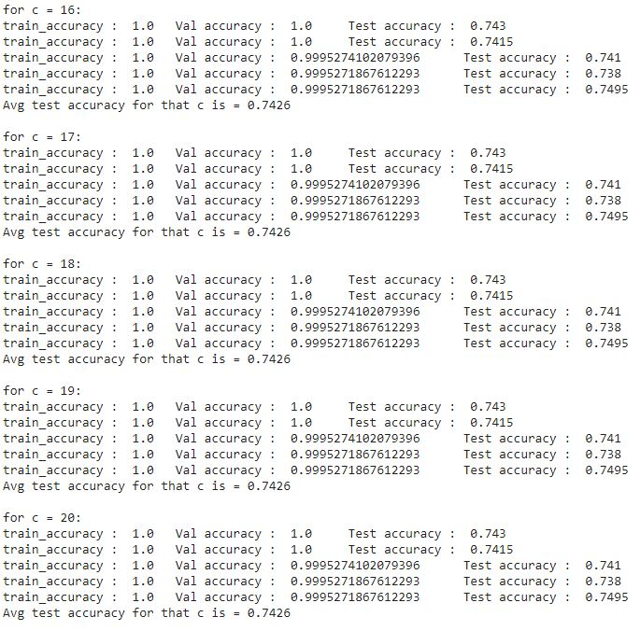
Here for c = 11.1, I got highest average test accuracy

Slide 12
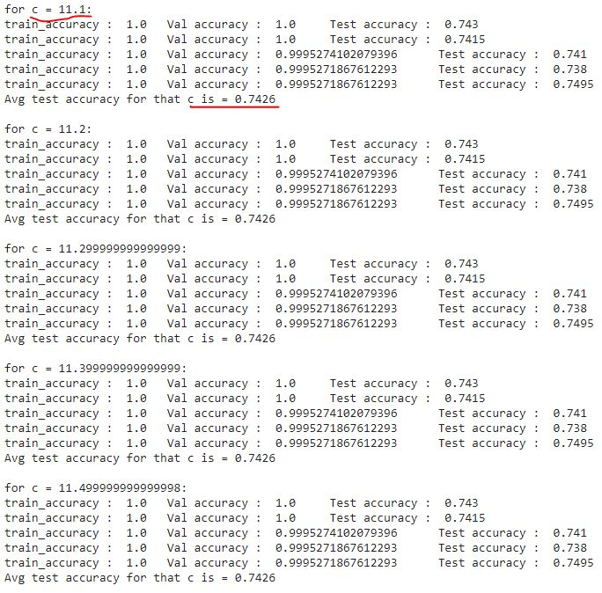
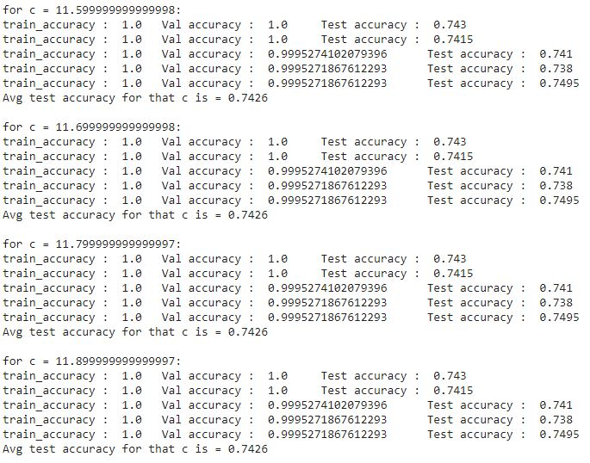
Here for c = 11.1, I got highest average test accuracy
So I choose c = 21.1

Slide 13
RandomForest Kmer DNC

Slide 14
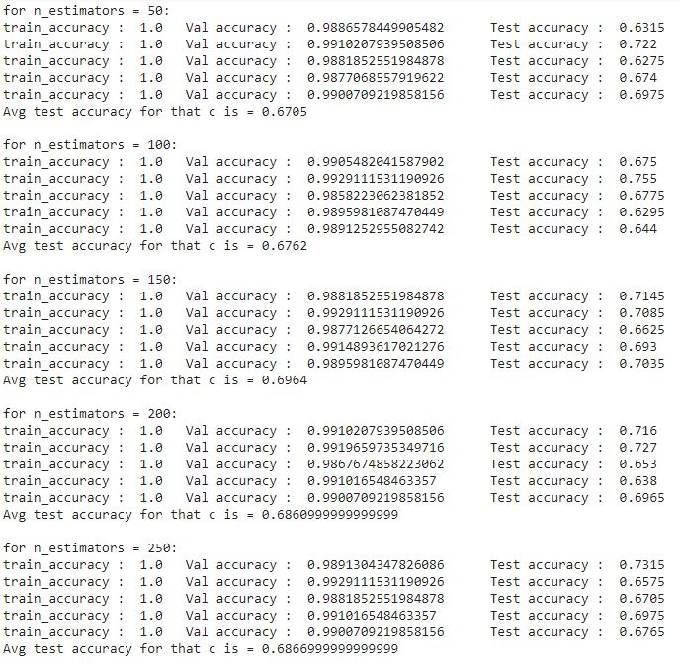
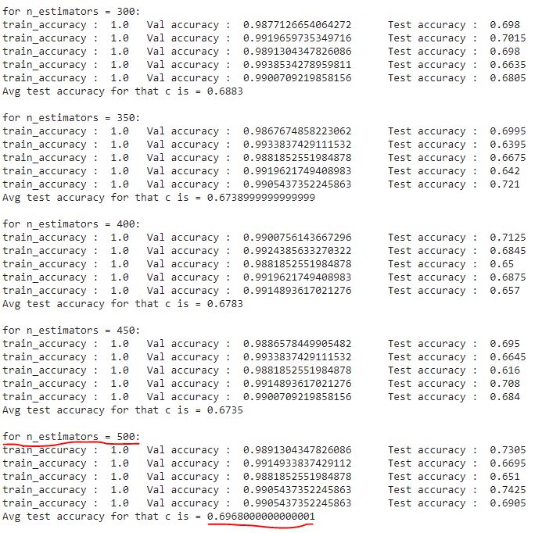
Here for n_estimators = 500, I got highest average test accuracy

Slide 15
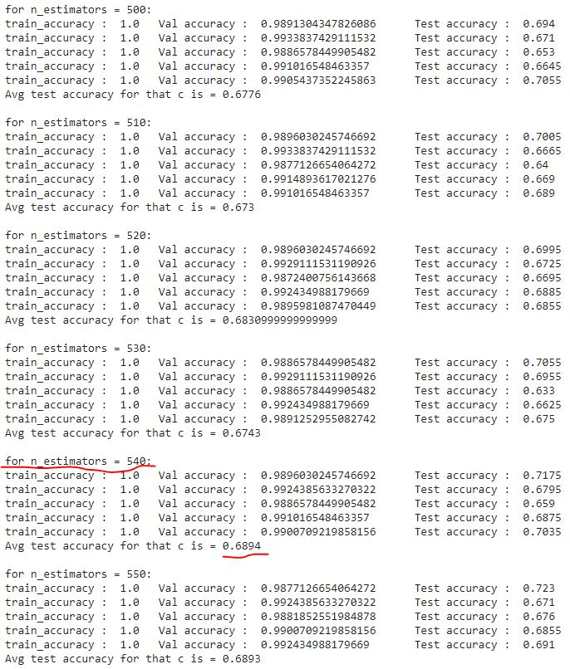
Here for n_estimators = 540, I got highest average test accuracy

Slide 16
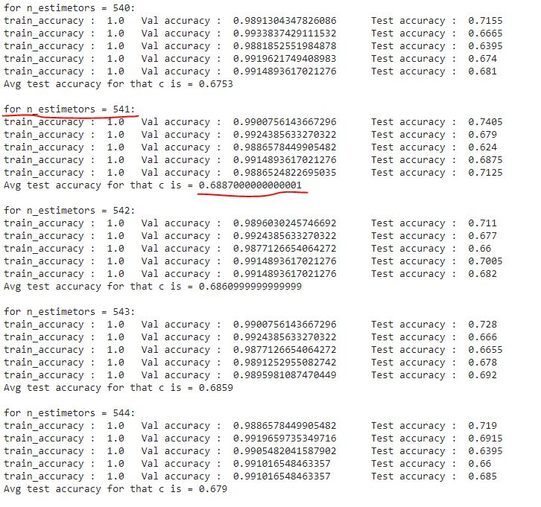
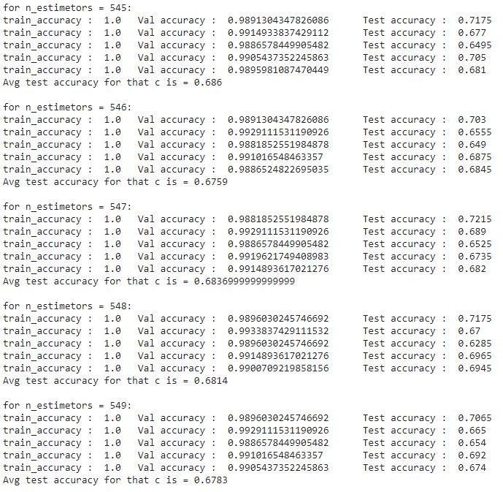
Here for n_estimators = 541, I got highest average test accuracy

Slide 17
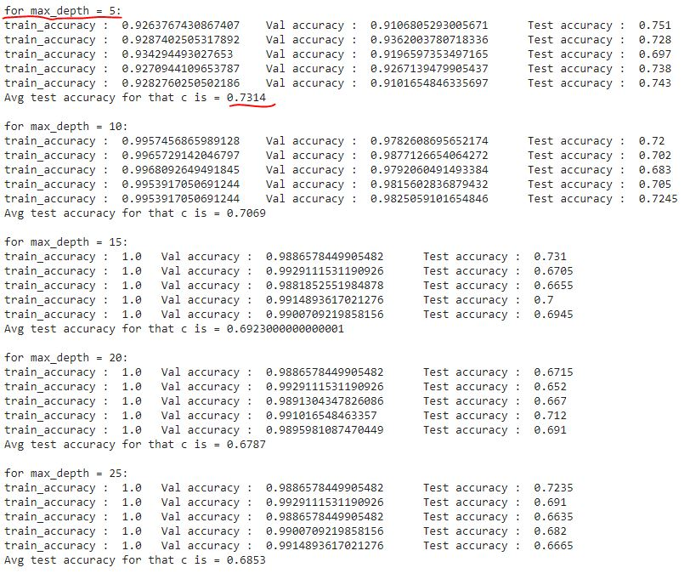
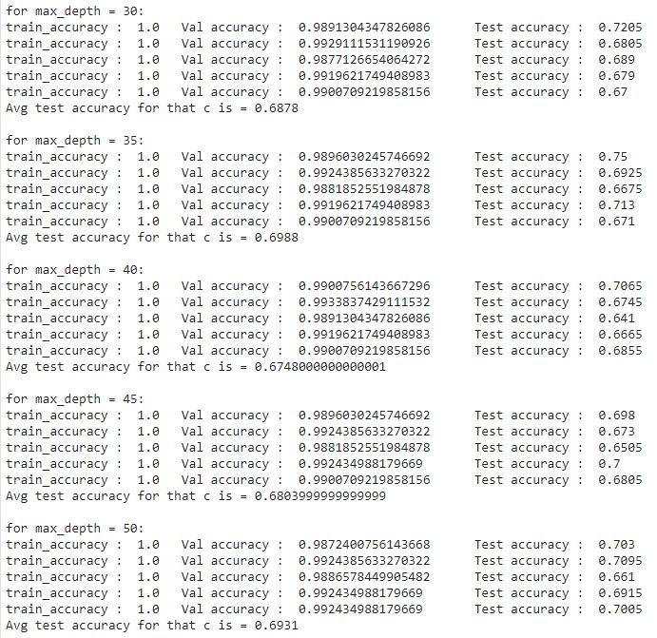
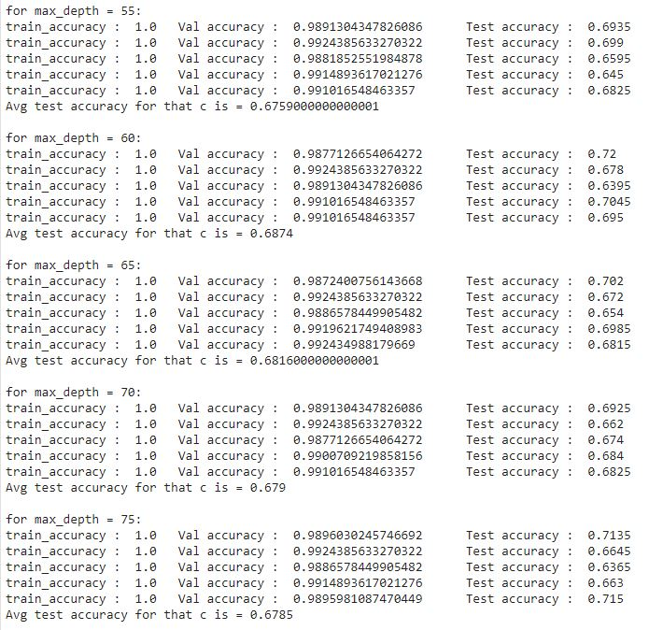
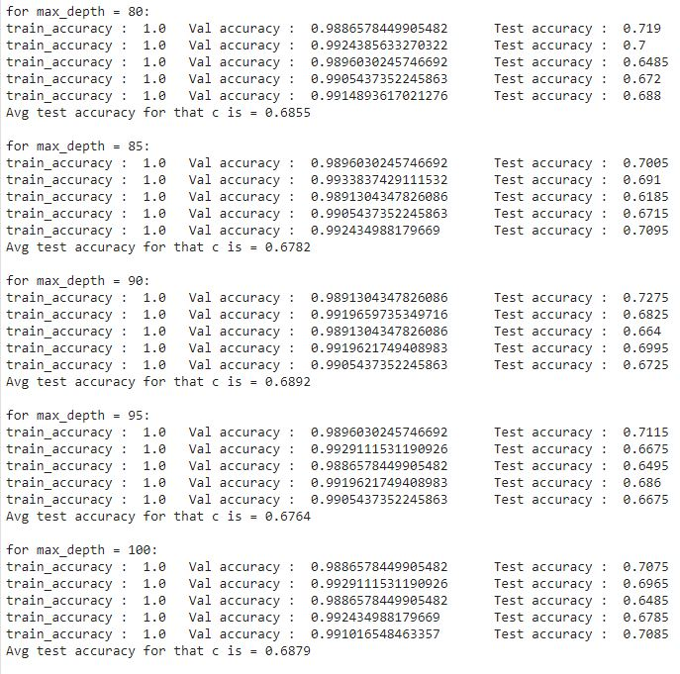
Here for n_estimators = 541 and max_depth = 5, I got highest average test accuracy

Slide 18
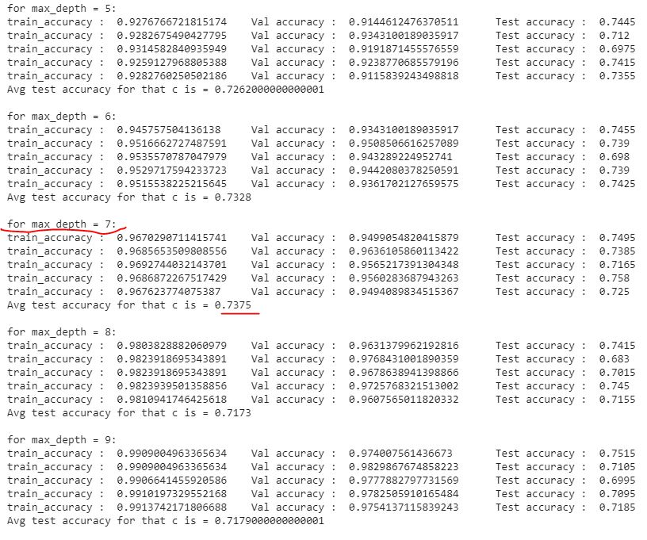
Here for n_estimators = 541 and max_depth = 7, I got highest average test accuracy
So I choose n_estimators = 541 and max_depth = 7

Slide 19
RandomForest Kmer TNC

Slide 20
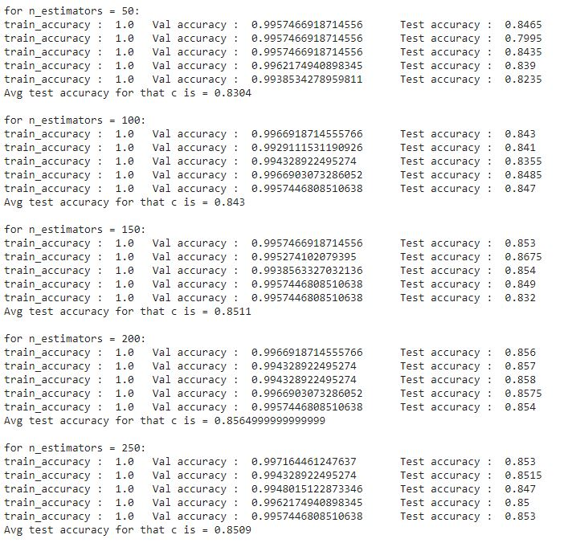
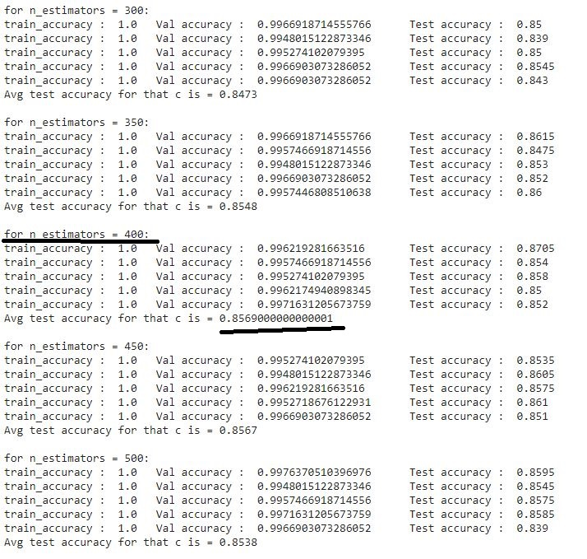
Here for n_estimators = 400, I got highest average test accuracy

Slide 21
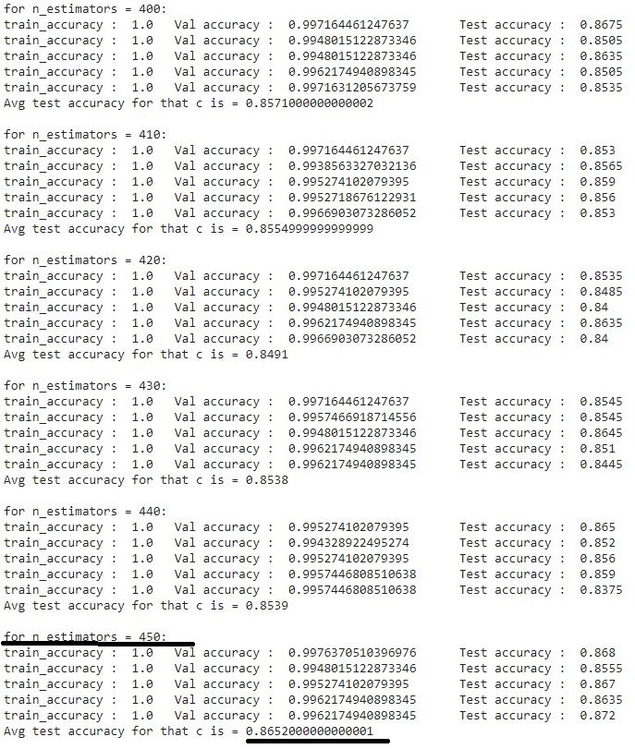
Here for n_estimators = 450, I got highest average test accuracy

Slide 22
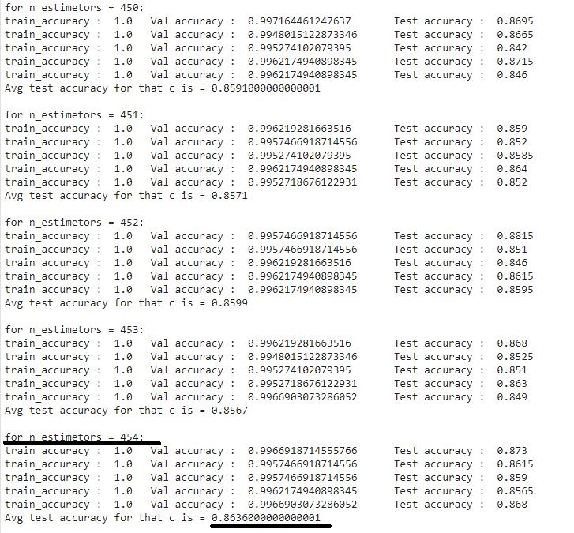
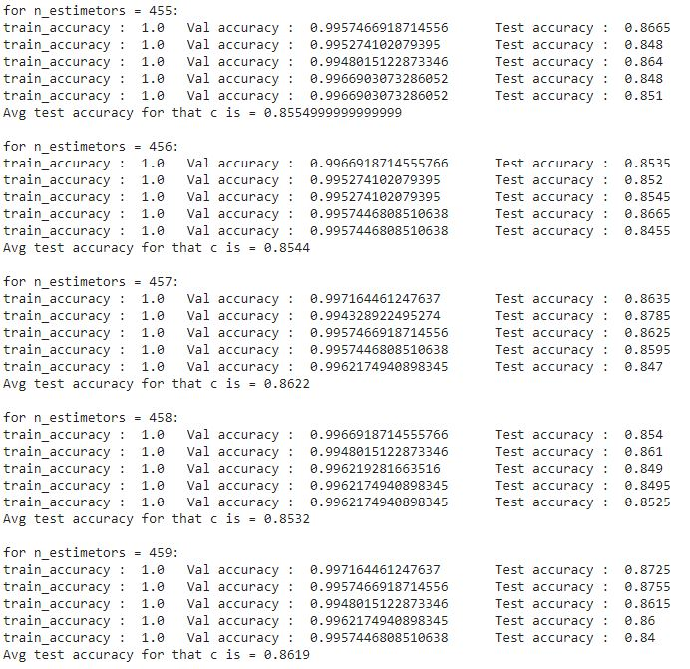
Here for n_estimators = 454, I got highest average test accuracy

Slide 23
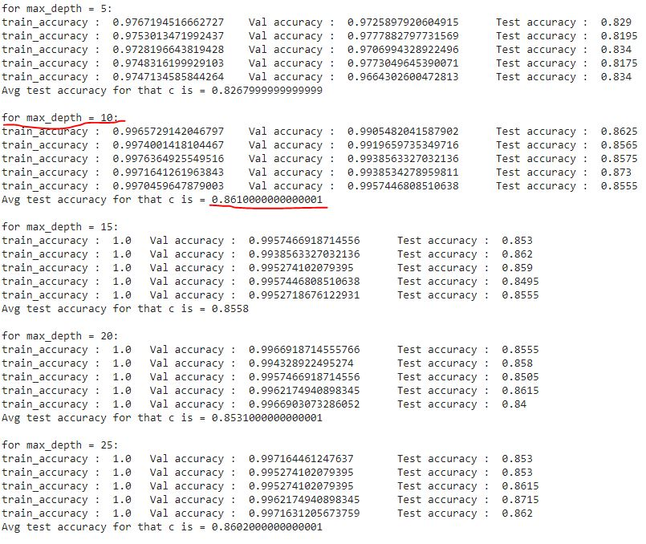
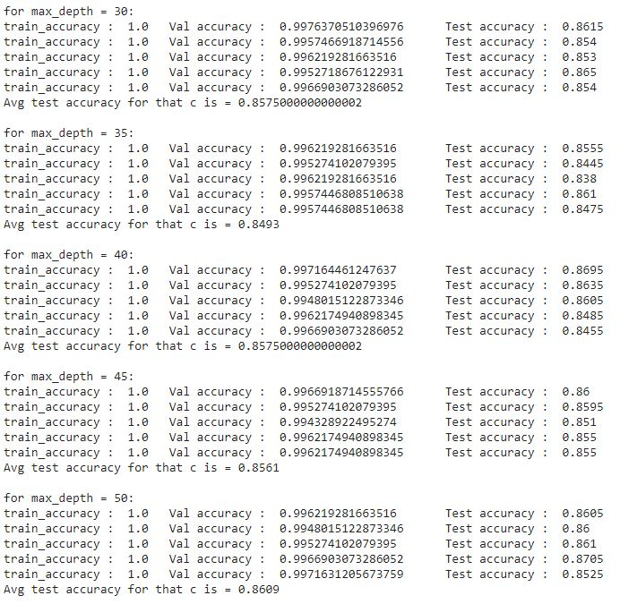
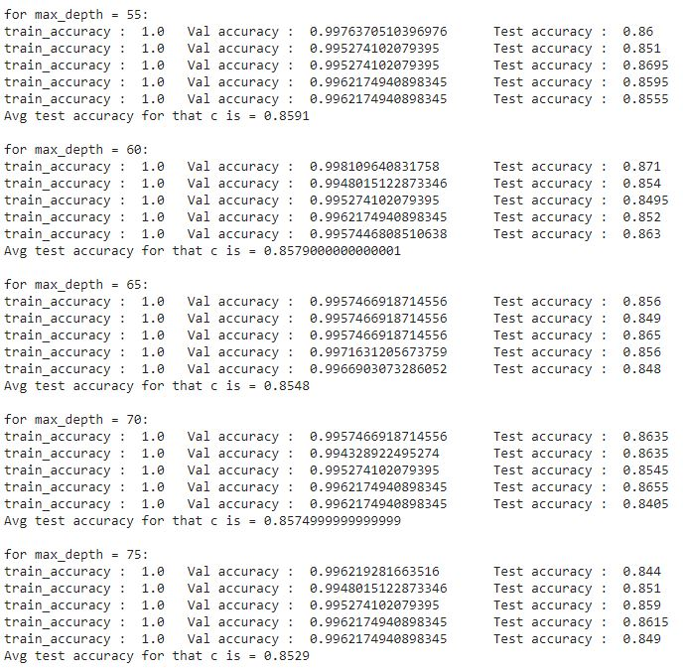
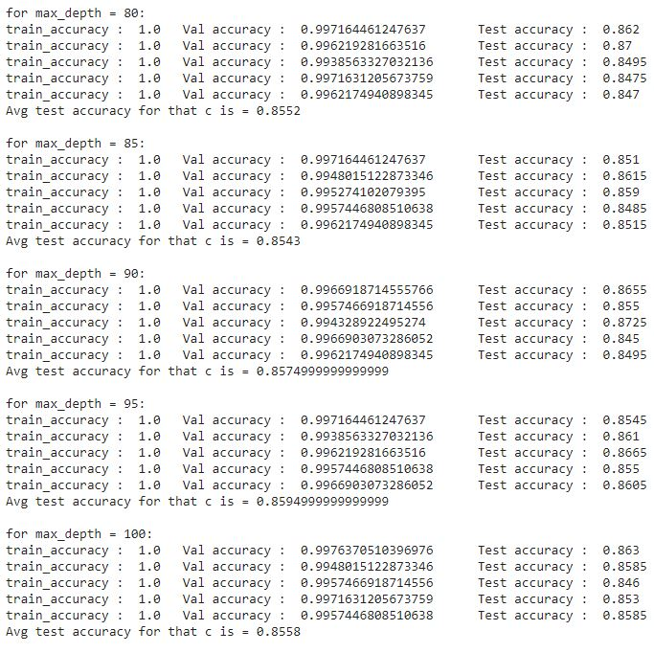
Here for n_estimators = 454 and max_depth = 10, I got highest average test accuracy

Slide 24
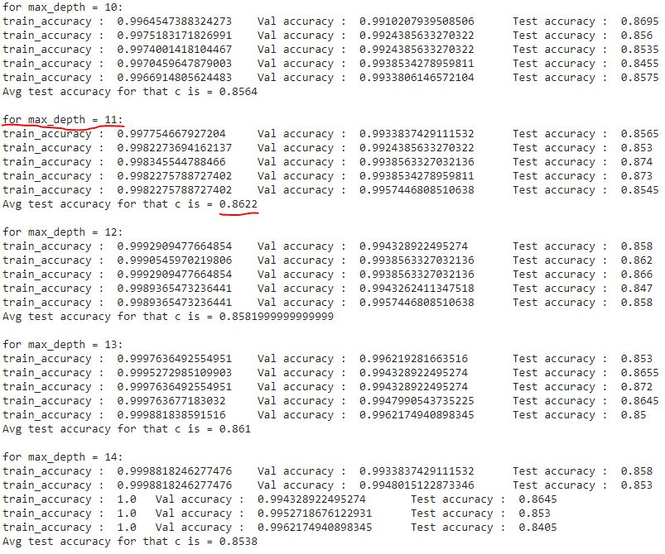
Here for n_estimators = 454 and max_depth = 11, I got highest average test accuracy
So I choose n_estimators = 454 and max_depth = 11

Slide 25
RandomForest Kmer (TNC + DNC)

Slide 26
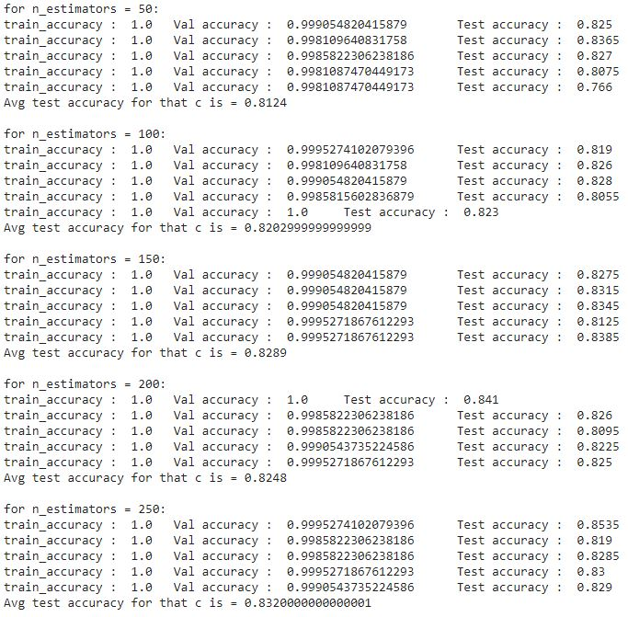
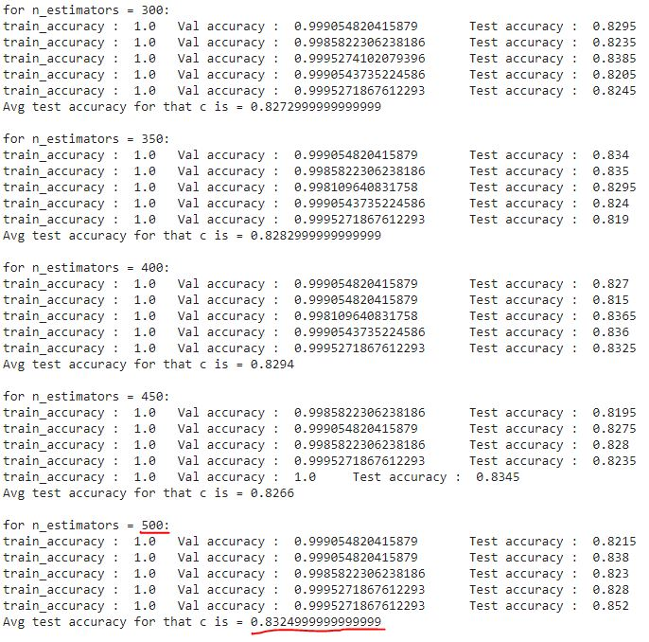
Here for n_estimators = 500, I got highest average test accuracy

Slide 27
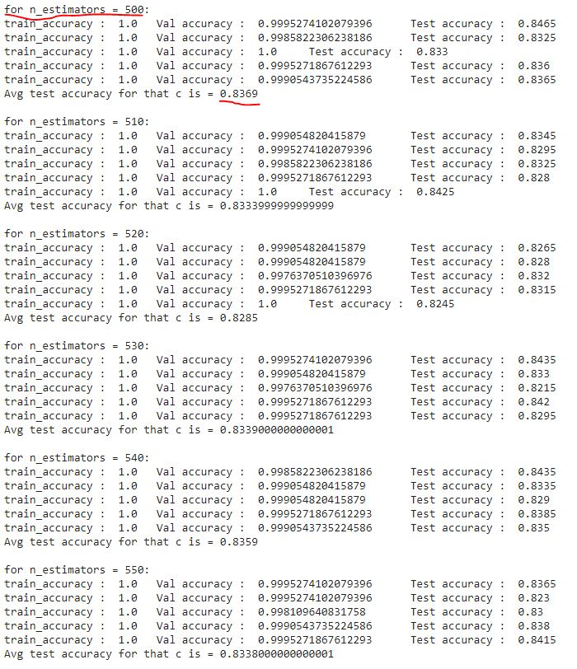
Here for n_estimators = 500, I got highest average test accuracy

Slide 28
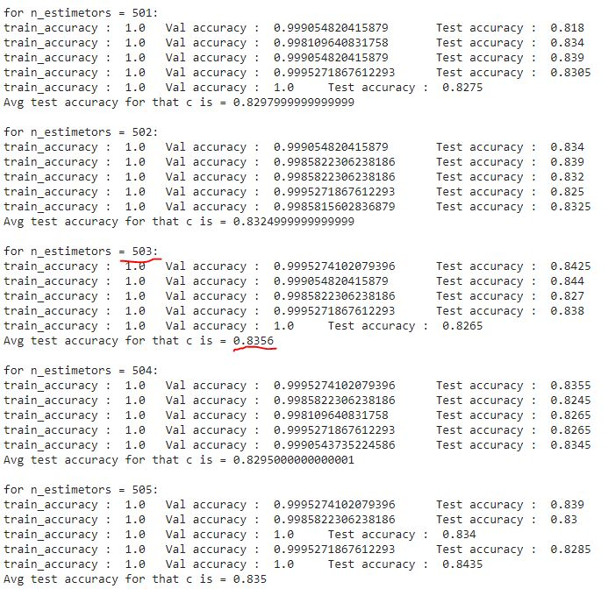
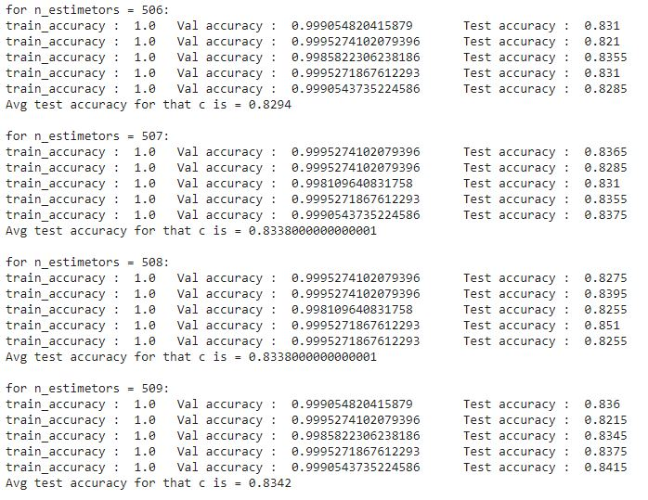
Here for n_estimators = 503, I got highest average test accuracy

Slide 29
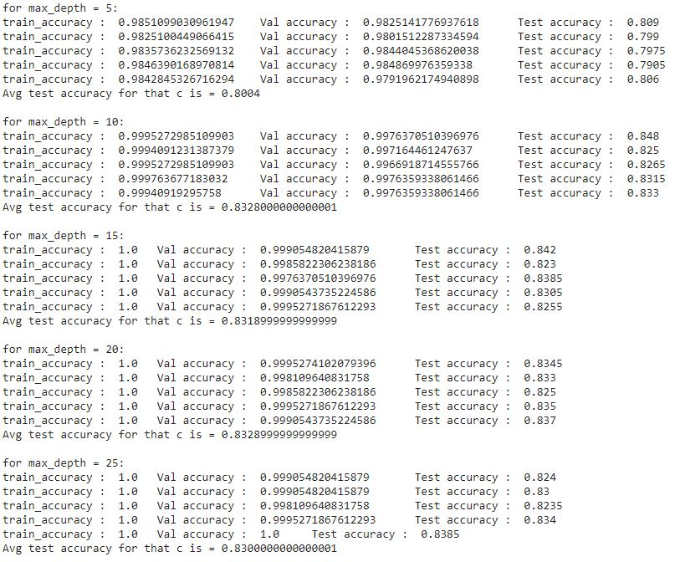
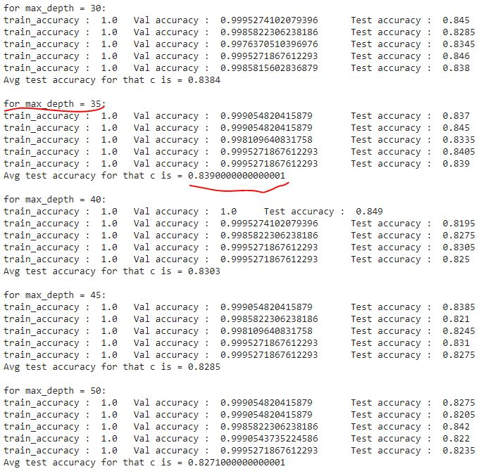
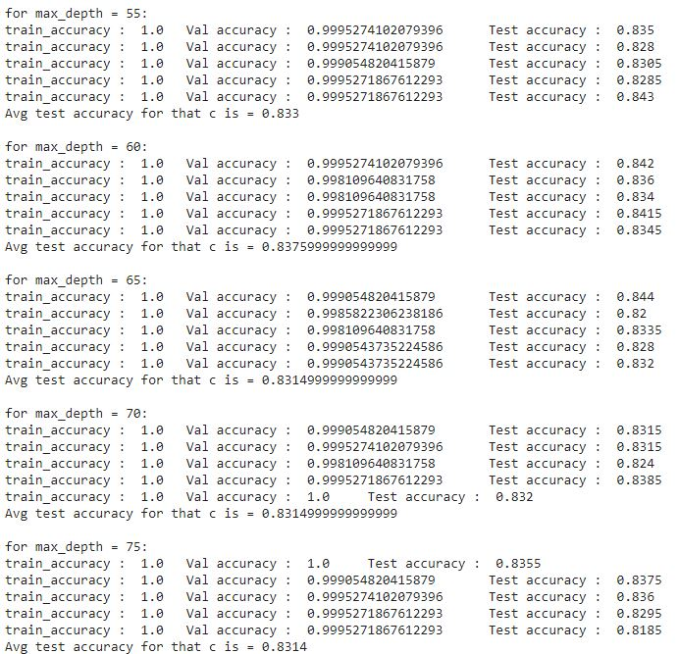
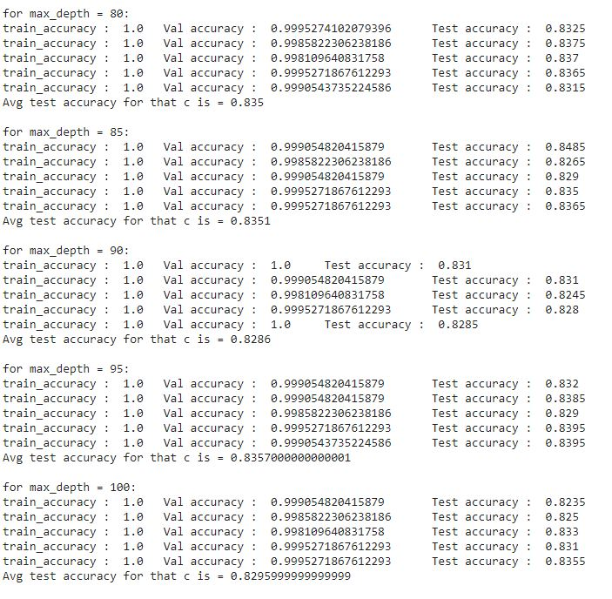
Here for n_estimators = 503 and max_depth = 35, I got highest average test accuracy

Slide 30
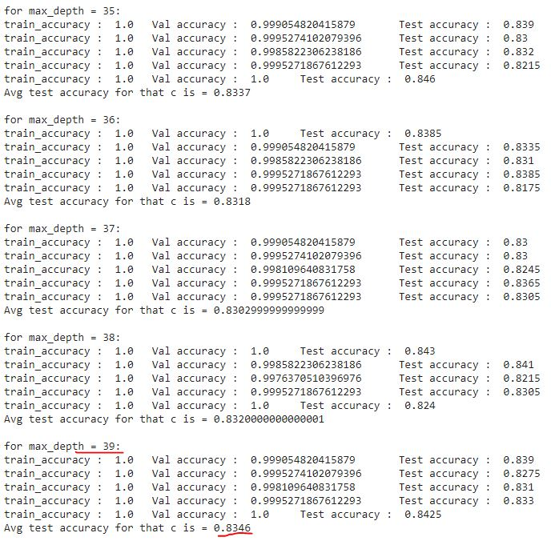
Here for n_estimators = 503 and max_depth = 39, I got highest average test accuracy
So I choose n_estimators = 503 and max_depth = 39

